Slide 1

Final Project Chess Classifier
Chris Sorenson
CSCI S-89 Introduction to Deep Learning
Summer 2021
Harvard Summer School
Chris Sorenson
<number>
Notes:
<number>

Slide 2
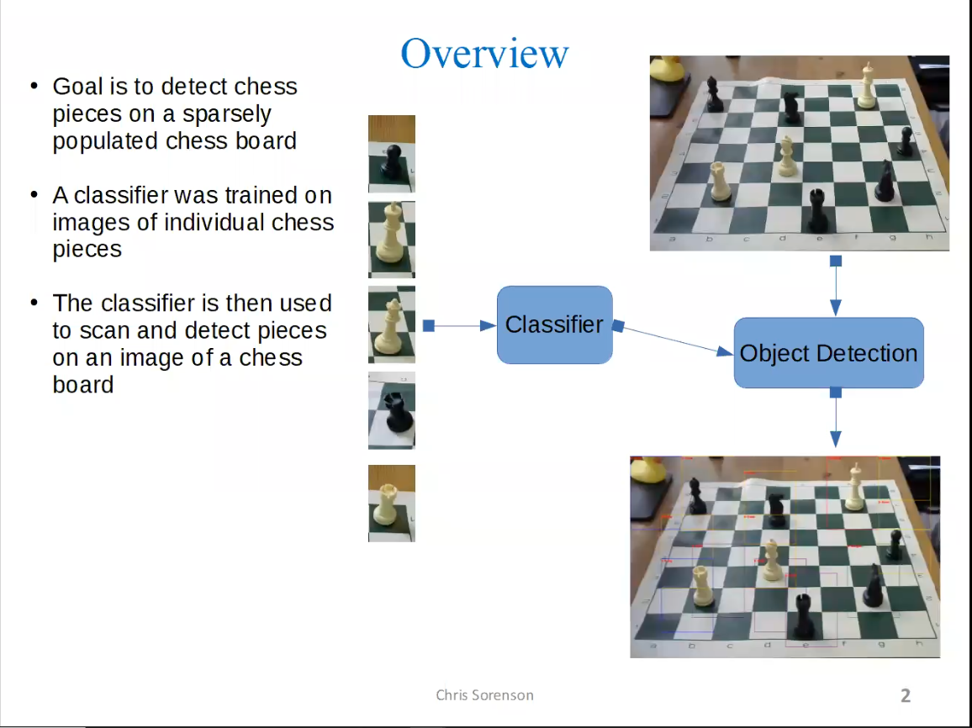

Slide 3
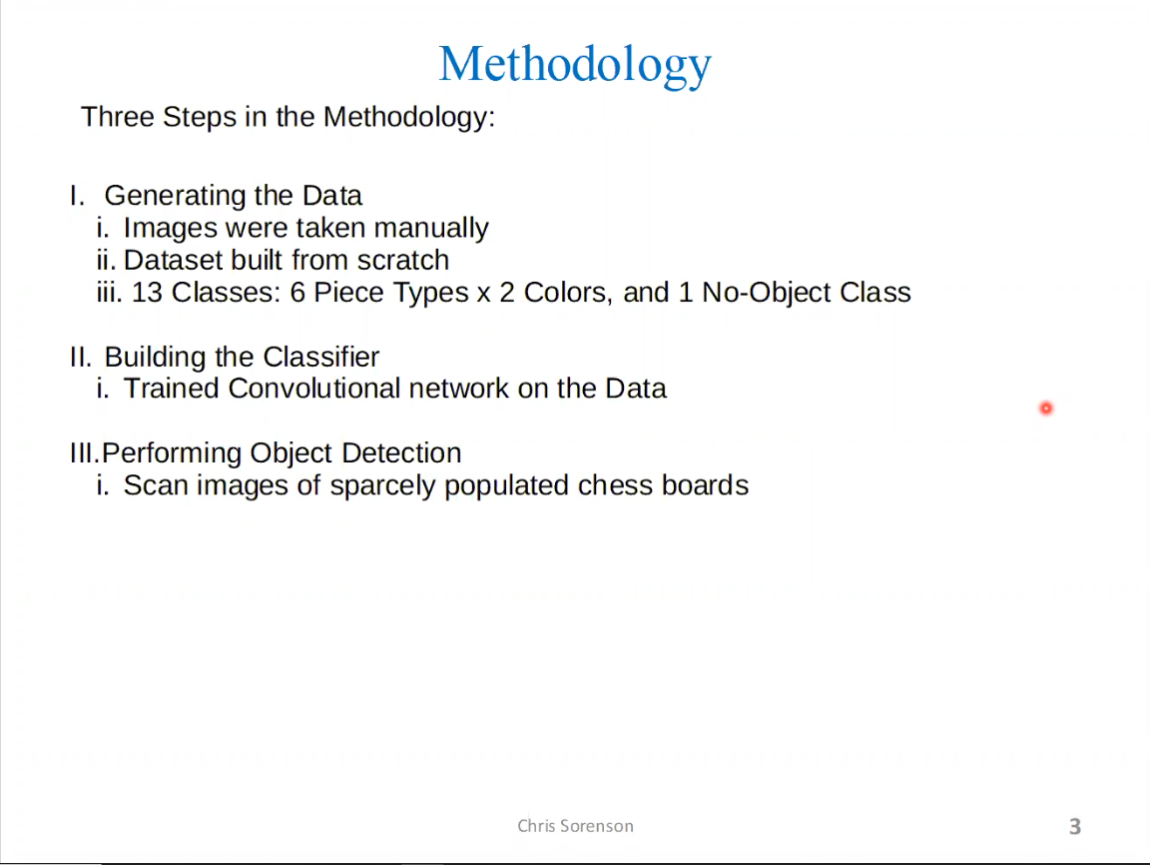

Slide 4
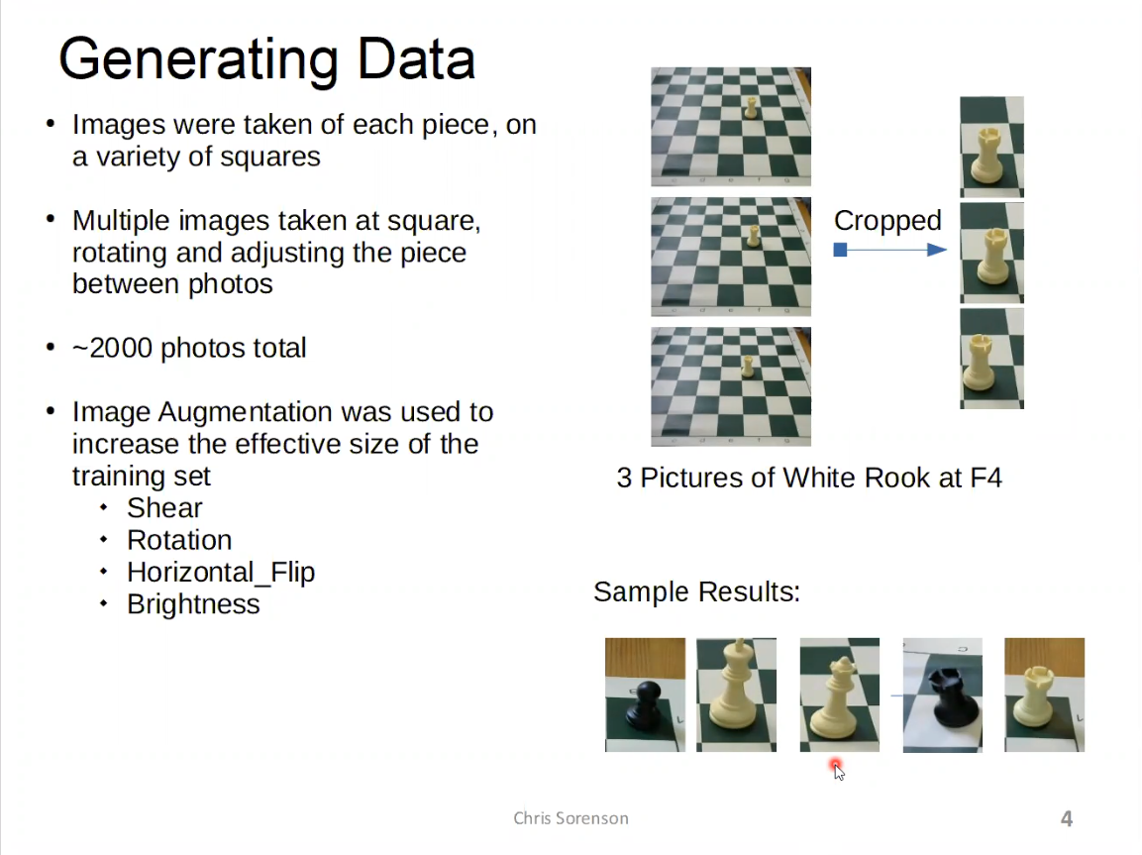

Slide 5
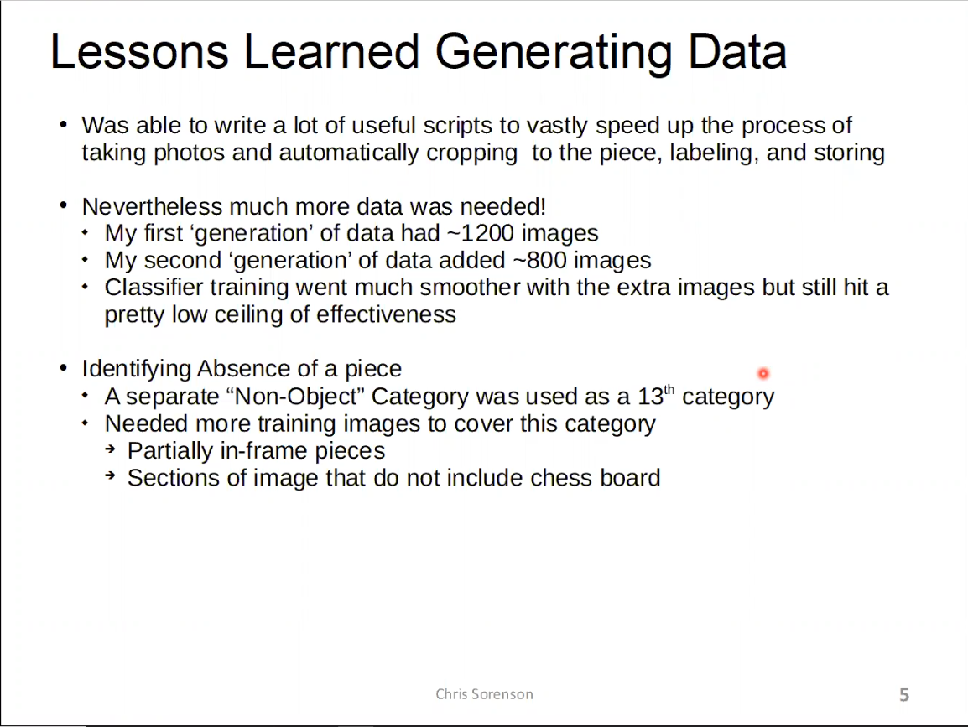

Slide 6
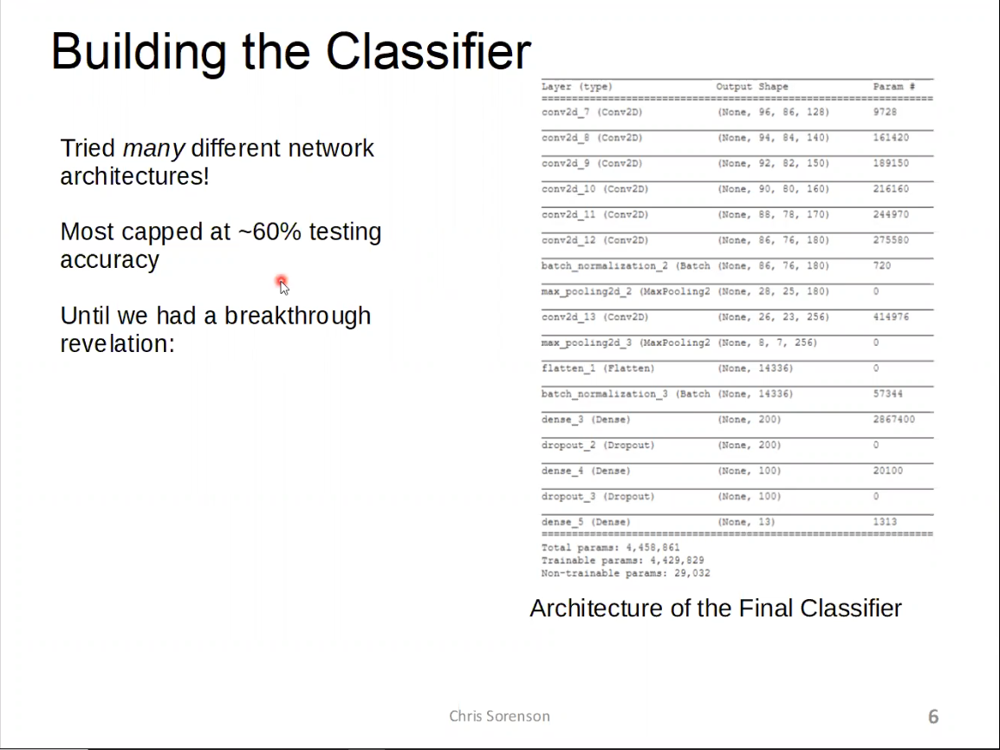

Slide 7
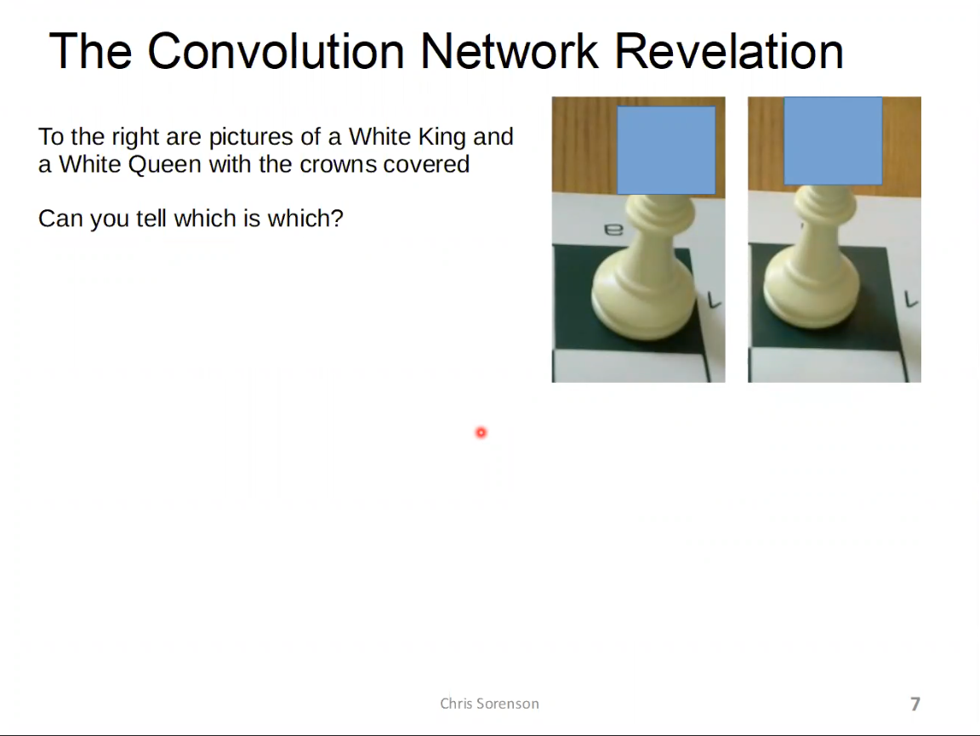

Slide 8
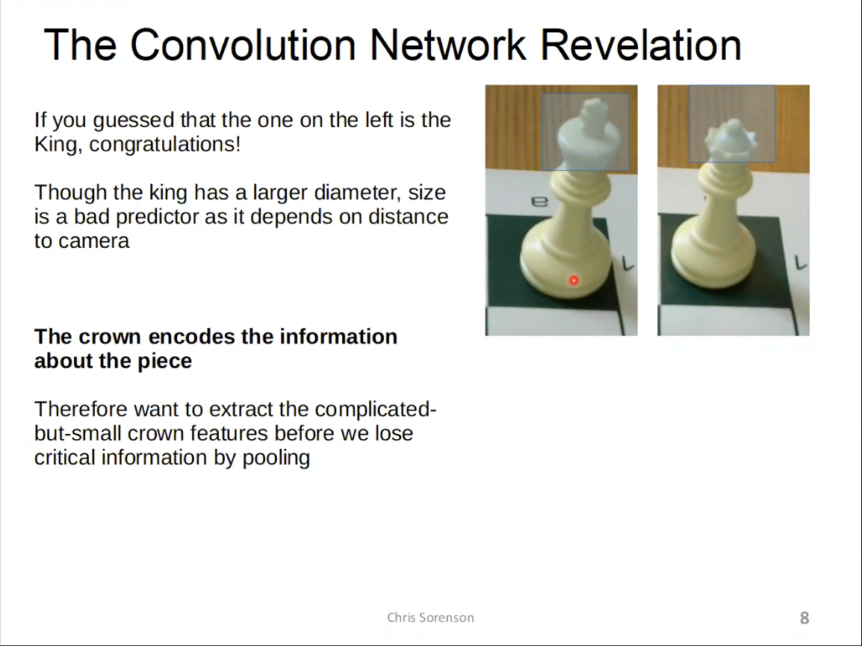

Slide 9
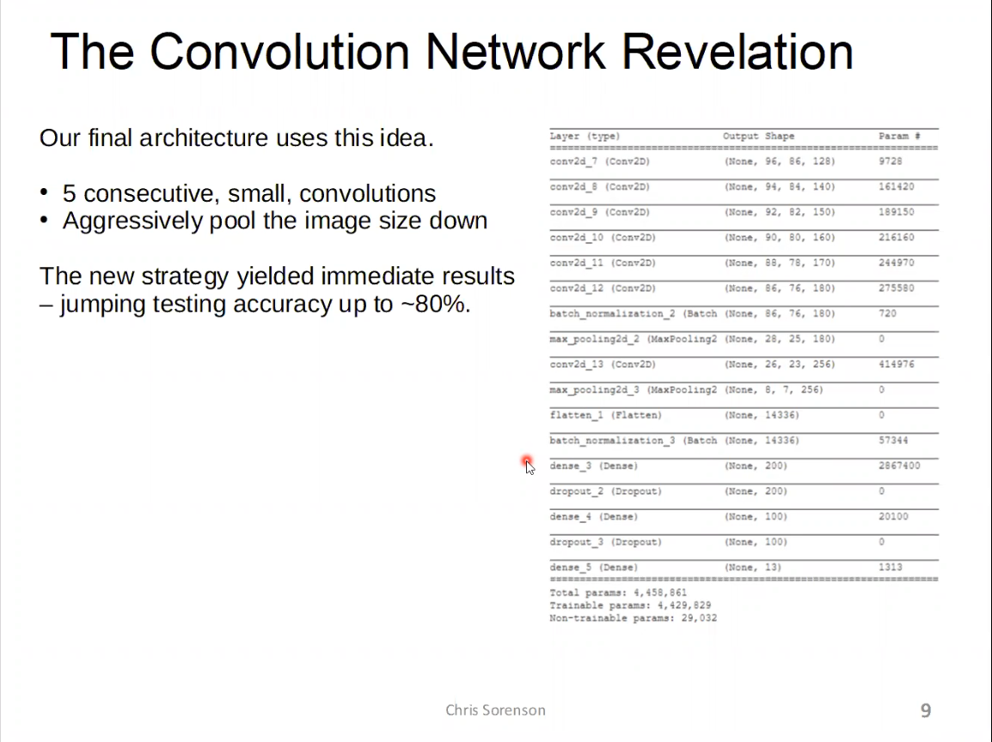
Introduction
@Your Name
<number>

Slide 10
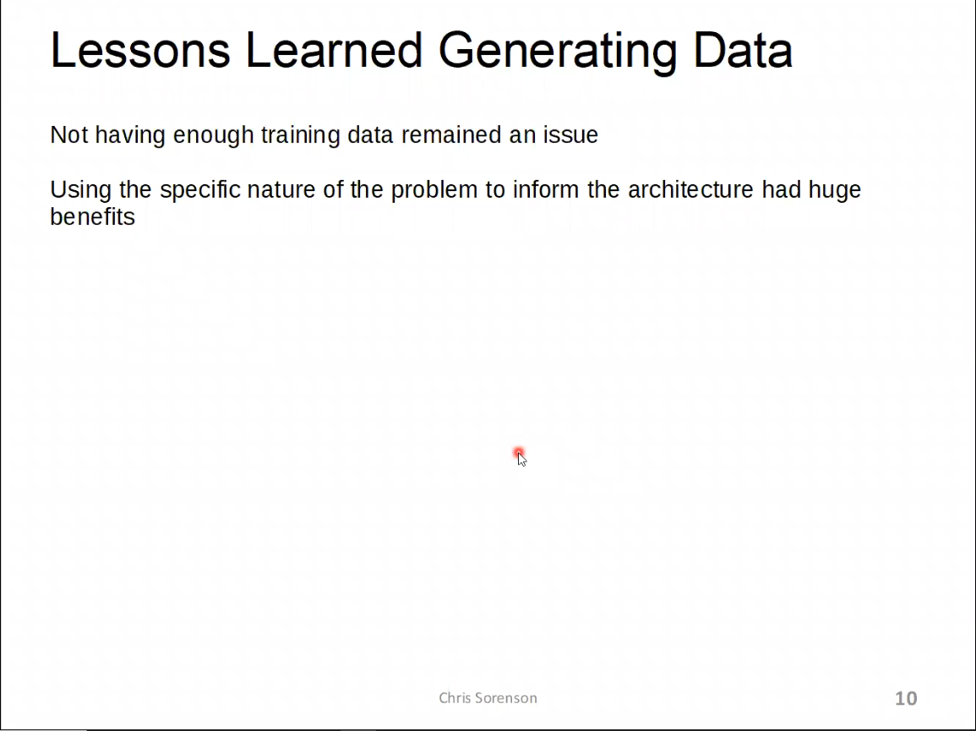
Methodology
@Your Name
<number>

Slide 11
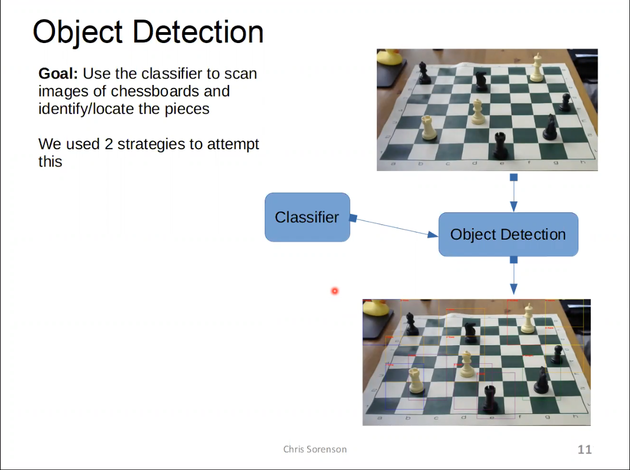

Slide 12
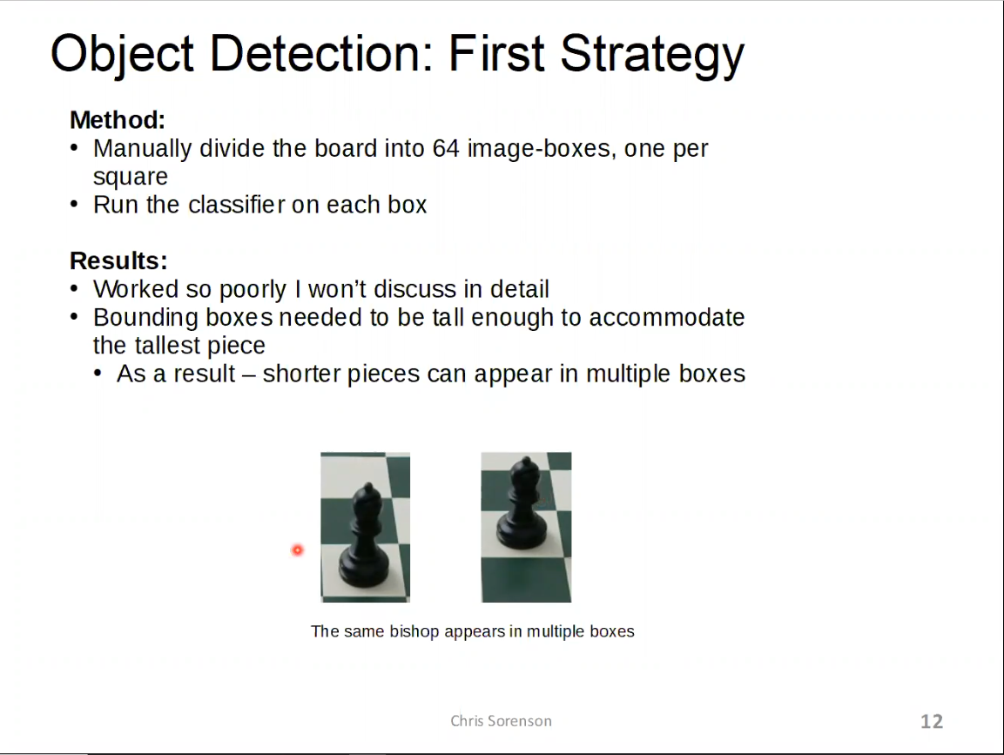

Slide 13
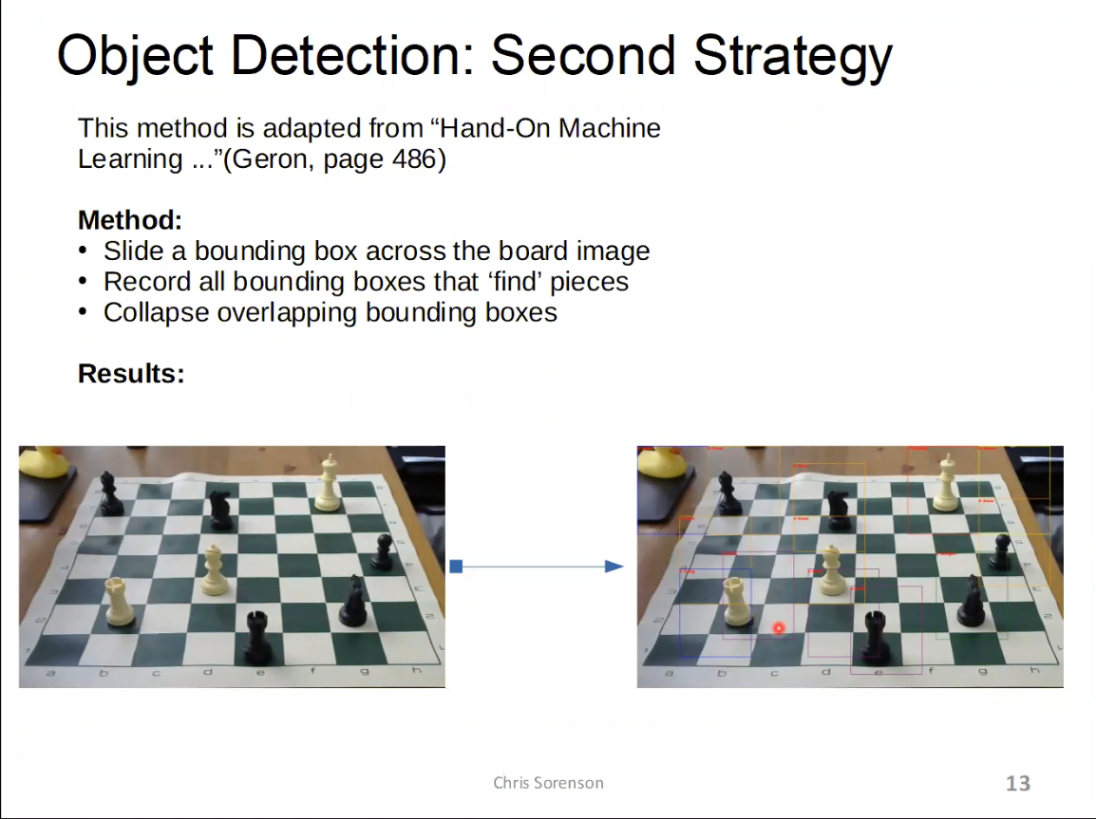

Slide 14
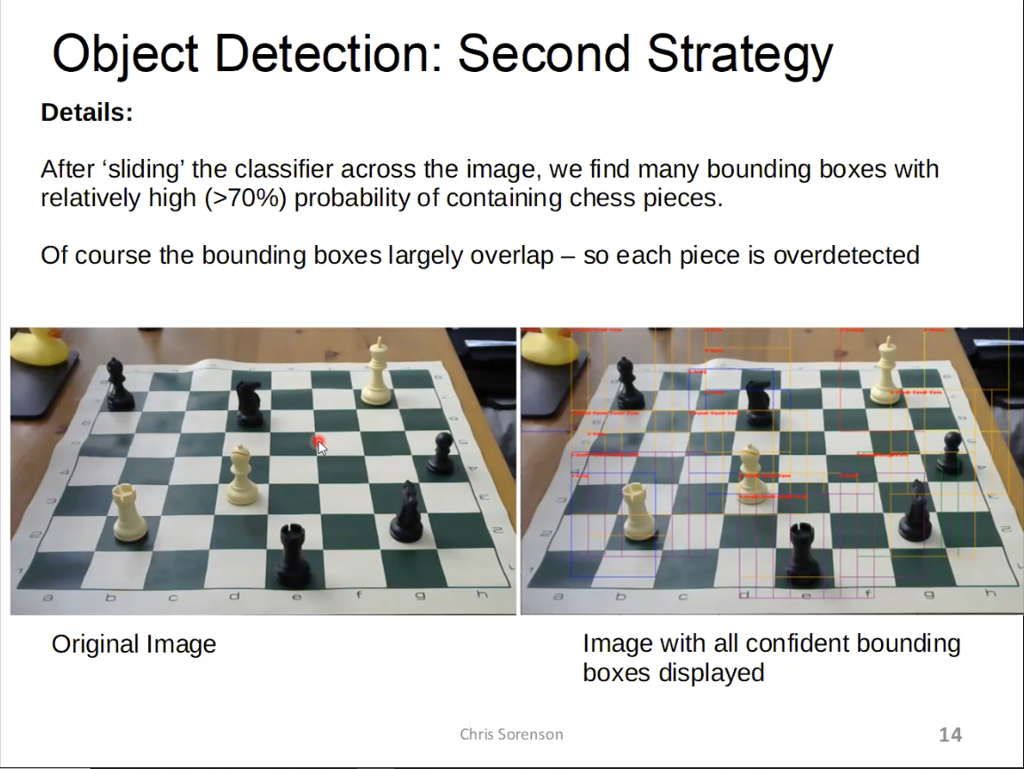

Slide 15
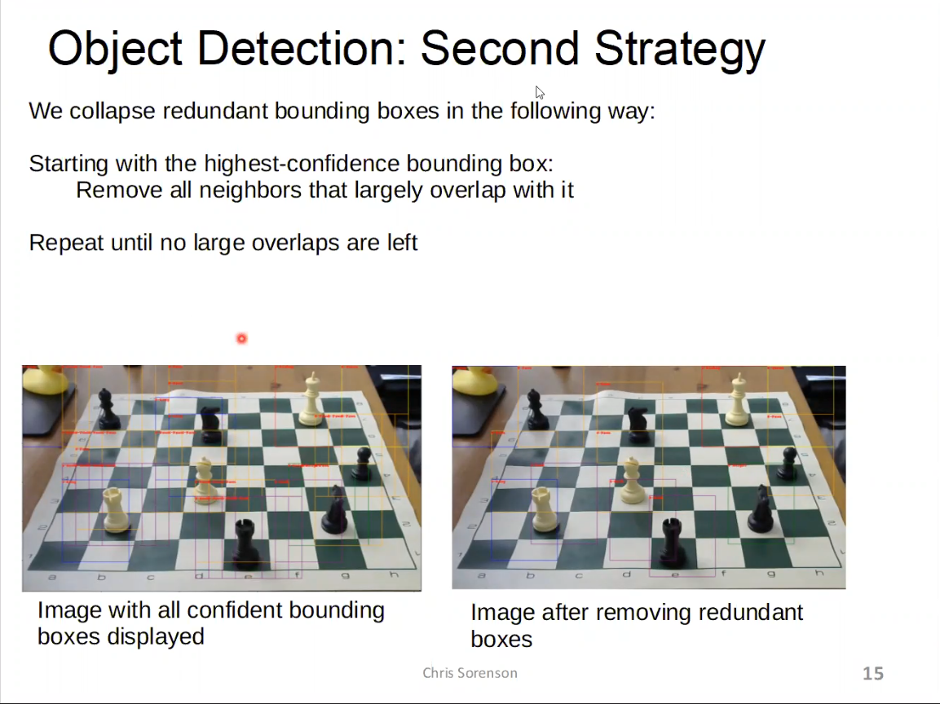

Slide 16
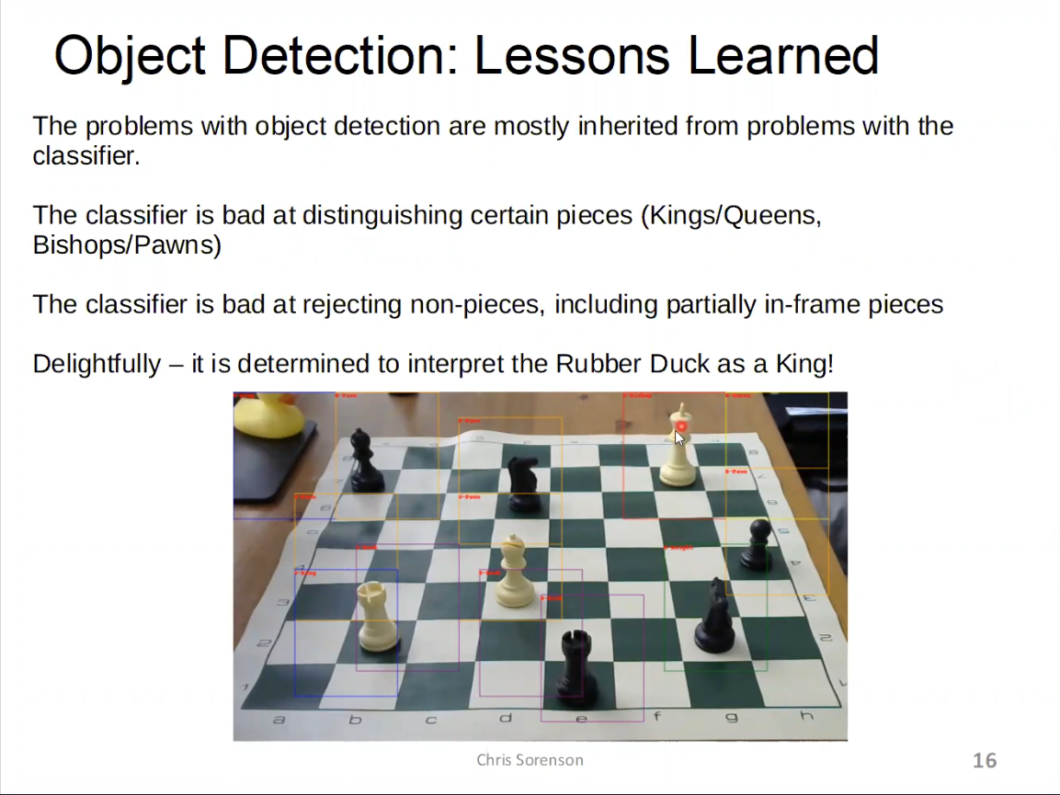

Slide 17
YouTube Video Presentation
YouTube video presentation:
https://www.youtube.com/watch?v=PZUjDJ6ALtw
Note: I accidentally deleted (without ever saving) these slides after recording the video. I then recreated the slides by taking screenshots from the video. That’s why these slides are just big images.
@Your Name
<number>

